Slide 1
Threads, Processes and Interprocess Communication
Ramaswamy Krishnan Chittur

Slide 2
Process
Provides the resources needed to execute a program.
Has a virtual address space, executable code, open handles to system objects, a security context, a unique process identifier, environment variables, a priority class, minimum and maximum working set sizes, and at least one thread of execution.
Is started with a single thread, often called the primary thread, but can create additional threads from any of its threads.

Slide 3
Thread
Entity within a process that can be scheduled for execution.
All threads of a process share its virtual address space and system resources. In addition, each thread maintains exception handlers, a scheduling priority, thread local storage, a unique thread identifier, and a set of structures the system will use to save the thread context until it is scheduled.
A thread lives in one and only one process. A process may have one or more threads.
Pointers are process specific, so threads can share pointers.

Slide 4
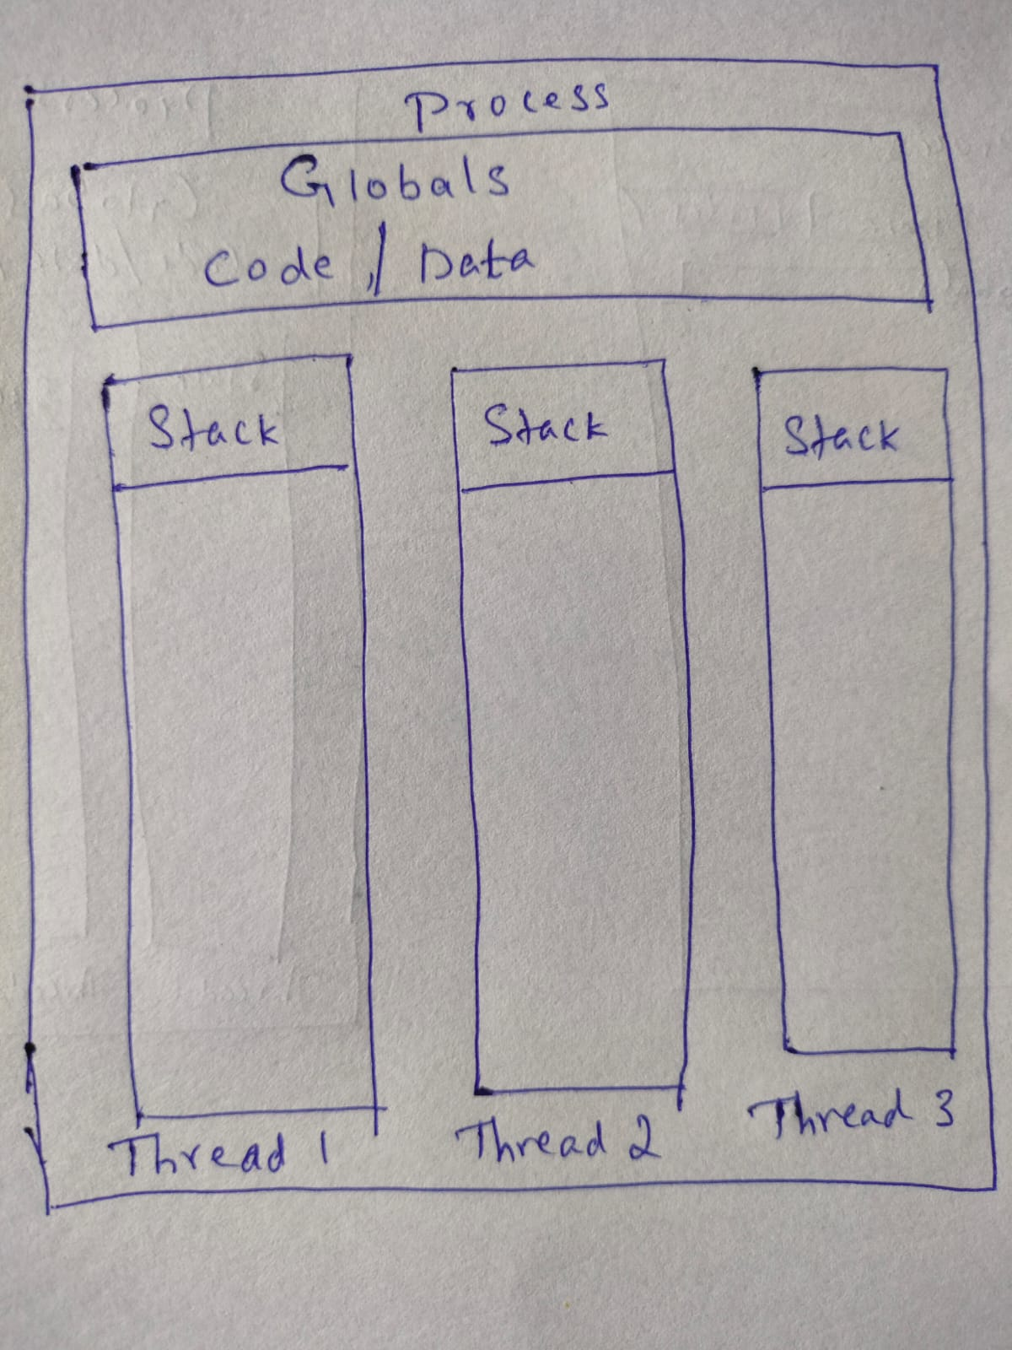
Process vs Thread
A process never executes anything per se; it is simply a container for threads.
Threads run in the context of a process. Each process has at least one thread.
A thread represents a path of execution that has its own call stack and CPU state.
Threads are confined to context of the process that created them.
A thread executes code and manipulates data within its process’s address space.
All threads of a process share its virtual address space. A thread can execute any part of the program code, including parts currently being executed by another thread.

Slide 5
Thread scheduling
Threads are the basic unit of scheduling in Windows.
Each thread is scheduled to run for some brief time period before another thread is given control of CPU.
A thread may be in one of three possible states:
Running
Blocked or Suspended
Ready to run

Slide 6
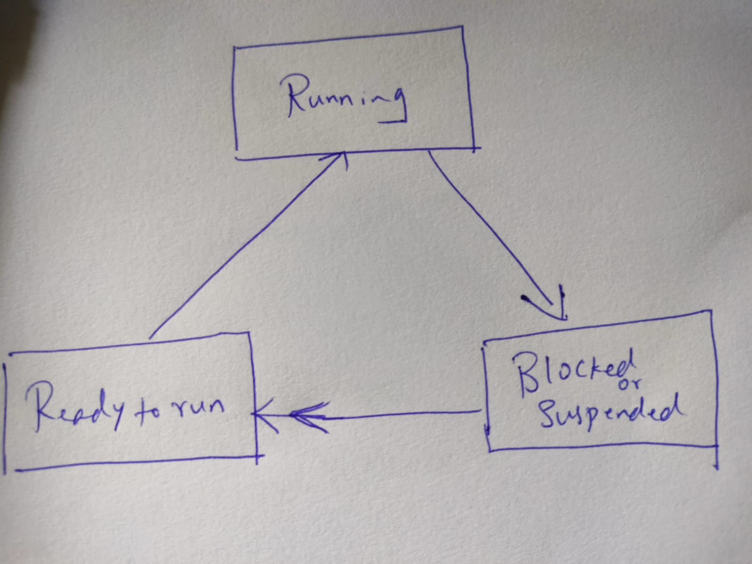
Thread states
A running thread typically enters blocked or suspended state if it blocked on waiting for some system resource, or its time slice expires.
Blocked/Suspended threads become ready to run when the resource they wait on becomes available or when their sleep interval has expired.

Slide 7
Thread Features
Managed Threads: .NET provides a nice interface to schedule and access threads. It is a nice wrapper over the threads provided by the OS. These are called managed threads.
Priority: Threads have priority. Higher priority threads are preferred while scheduling.
Foreground and Background Threads: A managed thread is either a background thread or a foreground thread. Background thread does not keep the managed execution environment running. Once all foreground threads have been stopped in a managed process, the system stops all background threads and shuts down.
Thread Pool: provides an application with a pool of worker threads that are managed by the system, allowing you to concentrate on application tasks rather than thread management.

Slide 8
Multithreading
Benefits:
Concurrency: code can run in parallel when needed.
Improve UI responsiveness: UI can be responsive while underlying functional processing runs.
Multicore friendly: Utilizes multiprocessor architecture where available.
Challenges:
Complex: More complicated to develop, manage and debug.
Conflict: Improper synchronization can lead to conflicting access to shared resources.
Race: In poorly written code, race conditions can occur as the order of completion is not deterministic.
Starvation: High priority threads can starve lower priority threads.
Priority inversion : a low priority thread holds a resource needed by a higher priority thread, blocking it from running.
Deadlock: Two or more threads each own resources needed by the other, preventing either one from running.

Slide 9
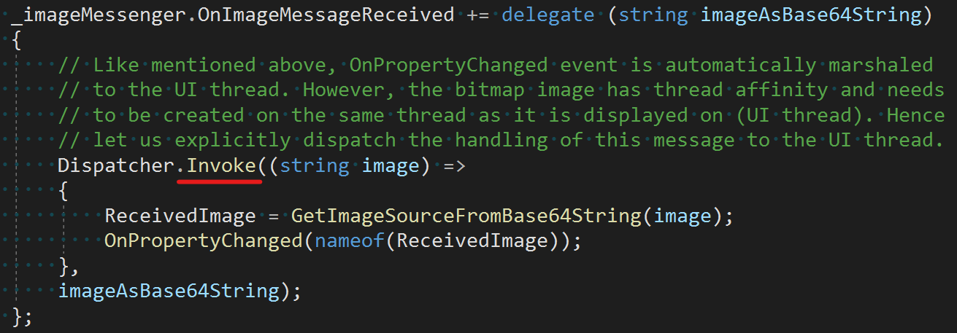
GUI and Worker threads
User Interface (UI) threads create windows, and process messages sent to those windows.
Worker threads receive no direct input from the user. Worker threads must not access a window’s member functions. Instead, they need to transfer the call to the UI thread to access/manipulate the window.
-

Slide 10
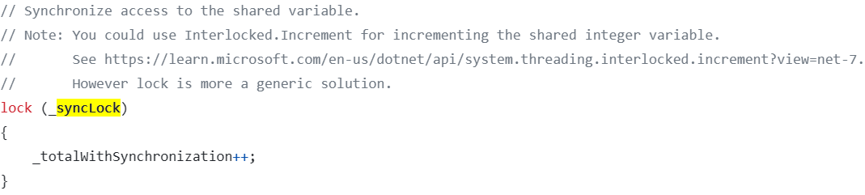
Thread synchronization
Multiple threads in the same program can access shared data. If access is not controlled to be sequential, then shared data may become corrupted. The process of making access serial is called serialization or synchronization.
There are various techniques for synchronization. The programmer may choose one or the other of these techniques based on the use case scenario.
Interlocked Operations
Critical Sections
Mutex
Semaphore
Monitor/Lock
Events
More…
Reference: Overview of synchronization primitives | Microsoft Learn

Slide 11
Interprocess communication (IPC)
Techniques for facilitating communications and data sharing between applications.
Can be between applications on the local device, or between applications running on different devices on the network.
Typically, applications can use IPC categorized as clients or servers. A client is a process that requests a service from some other process. A server is a process that responds to a client request. Many applications act as both a client and a server, depending on the situation.
One way to categorize Inter-process communication is about how the objects interact cross process: as such we can categorize the techniques into:
Inter-Object Communication.
Serialized Message Passing.
Reference: Interprocess Communications - Win32 apps | Microsoft Learn

Slide 12
Inter-Object Communication Versus Serialized Message Passing
Inter-Object Communication:
Allows clients to communicate transparently with objects, regardless of where those objects are running—in the same process, on the same computer, or on a different computer. This provides a single programming model for all types of objects, and for both object clients and object servers. See here.
The underlying technique here is Marshaling: It is the mechanism by which an object that is accessible to one process can be made accessible to another process by the underlying IPC technique (unless the user wants to override it). See here.
A few technologies that provide inter-object communication are: .NET Remoting, COM, Remote Procedure Call.
Serialized Message Passing:
Requires the clients to serialize data into bytes before they are shared across processes.
Serialization is the technique of converting the state of an object into a form that can be persisted or transported. See here.
A few technologies where you would use serialization for IPC are: Named pipes, Sockets, Udp/Tcp clients

Slide 13
IPC: Considerations
Benefits:
Isolation: code can be run in a different process. This is particularly helpful when you are executing 3rd party or untrusted code. If they were to run in-process, they could potentially compromise the security or reliability of your process.
Concerns:
Security, Elevation of privilege: A higher privileged process passing data into a lower privileged process can compromise the security of the data.
Security, Snooping: Data passed across processes may be listened to by unauthorized processes.
Security, Man-in-the-middle: An attacker can alter the messages while it is in transit.
Performance: IPC is typically more expensive and slower than in-process / in-memory operations.

Slide 14
Example
Multithreading demo: chittur/multithreading-demo: Demonstrates multithreading and synchronization among a few other concepts. (github.com)
Synchronization for multithreading demo: chittur/multi-threading-synchronization: A sample project that demonstrates the need for synchronization in multi-threading. (github.com)
GUI and worker threads demo: chittur/distributed-and-gui-demo: Demonstrates a distributed computing software that also involves GUI (github.com)
Interprocess Communication demo: chittur/inter-process-communication: Sample project that demonstrates inter-object communication as well as serialized message passing. (github.com)

